Slide 1
Lesson 1: Oysters as a Keystone Species
Lesson 1 Goal: Support the claim above with evidence and reasoning that explains why oysters are an important part of their ecosystem.
Notes:
WHen you introduce today’s lesson and goal, you may want to ask students to share if they already have any ideas based on the exploration about why oysters are an important part of their ecosystem.

Slide 2
Share some of the observations and data you were able to collect when we explored the oyster clusters.
Notes:
Ask students to look back over their data and have a group discussion about what the data. Listen for someone to describe one individual species.

Slide 3
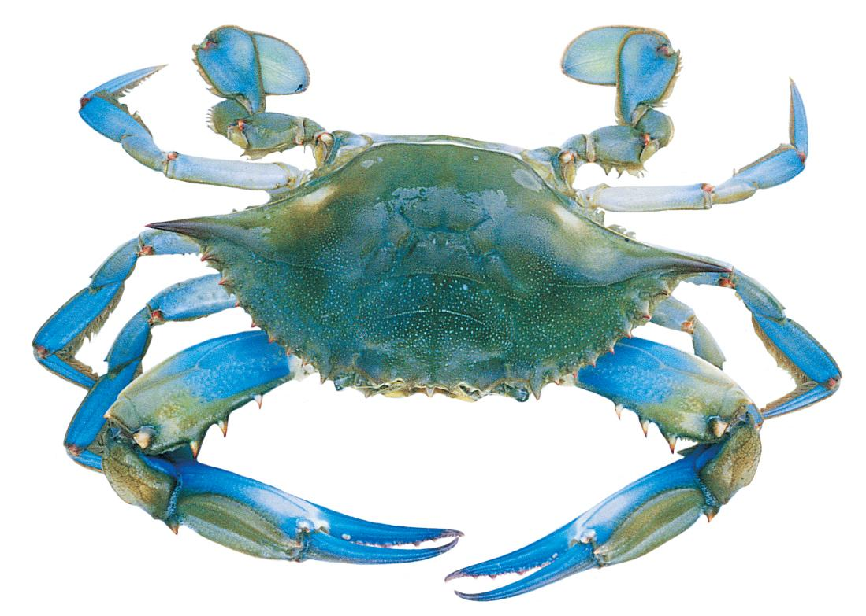
Organism
Any living thing.
An individual is just one organism.
A species is a group of organisms that can reproduce.
Individual organisms of the same species may have different traits, but are still the same species because they can reproduce.
Blue Crab, Callinectes sapidus
Notes:
Define organism for the students. You may wish to have them create their own visual vocabulary for the terms.

Slide 4
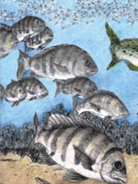
Population
A group of individual organisms of the same species that live in one area.
Example: The oyster population of the Mud River has increased in the last ten years.
Example: The oyster population in North America is declining.
Sheepshead, Archosargus probatocephalus
Notes:
Ask students if anyone found more than one of a certain species. Ask them to share the total population of mud crabs (or any other species) in their clump, and then find the population of the entire sample (all groups totals added together). Make the point that population has to do with location and sample size, but sometimes scientists might discuss the population of a species in global terms, especially if that species is threatened or eng=dangered.

Slide 5
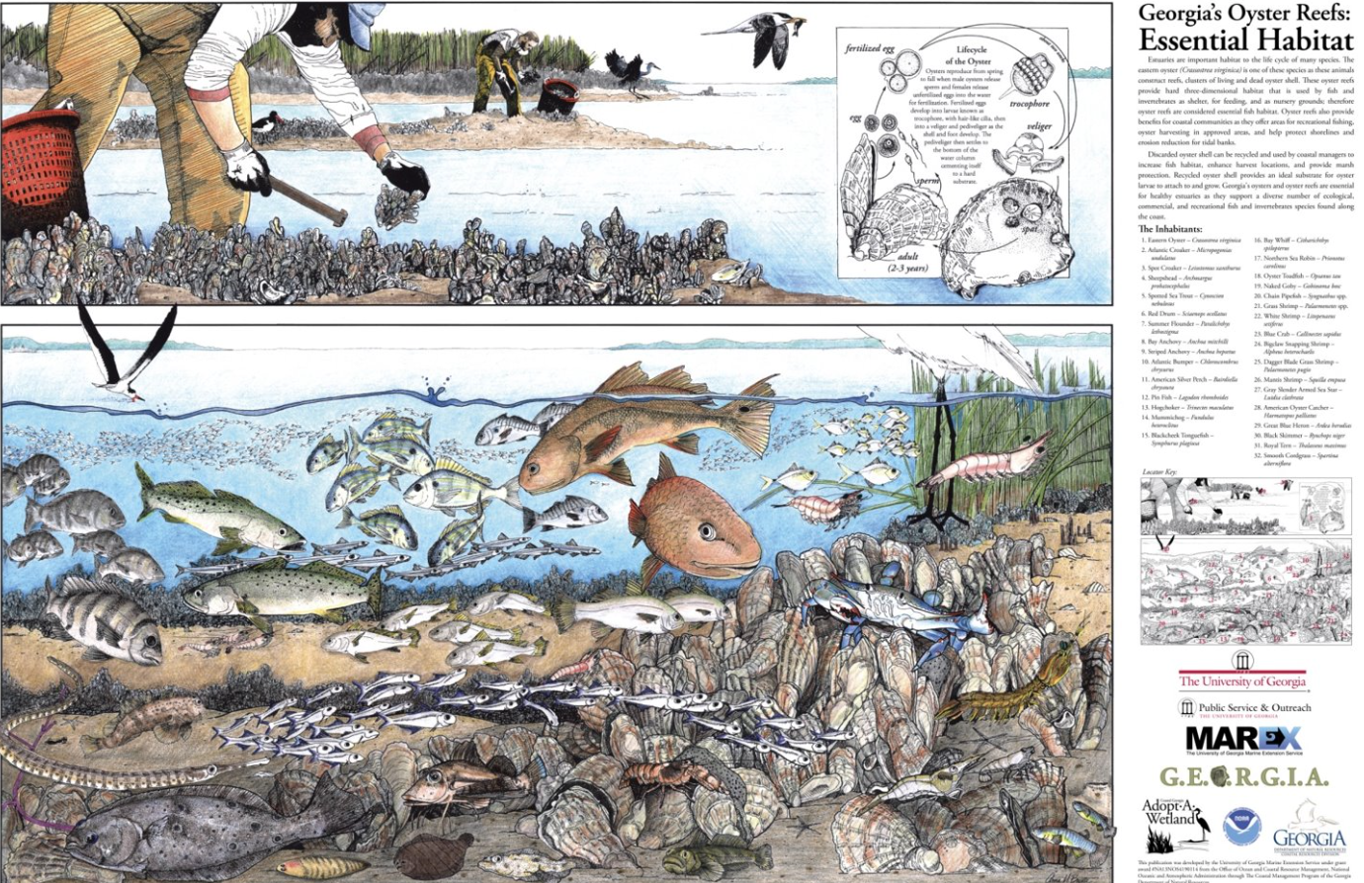
Community
A group of populations of two or more different species occupying the same area at the same time.
Notes:
Ask students what species made up their oyster reef community, or discuss the different community members found on an oyster reef.

Slide 6
Ecosystem
All the organisms and their physical environment with which they interact. The biotic and abiotic components of an ecosystem are linked together through nutrient cycles and energy flows.
Notes:
Ask students to identify some of the abiotic components of the oyster reef.

Slide 7
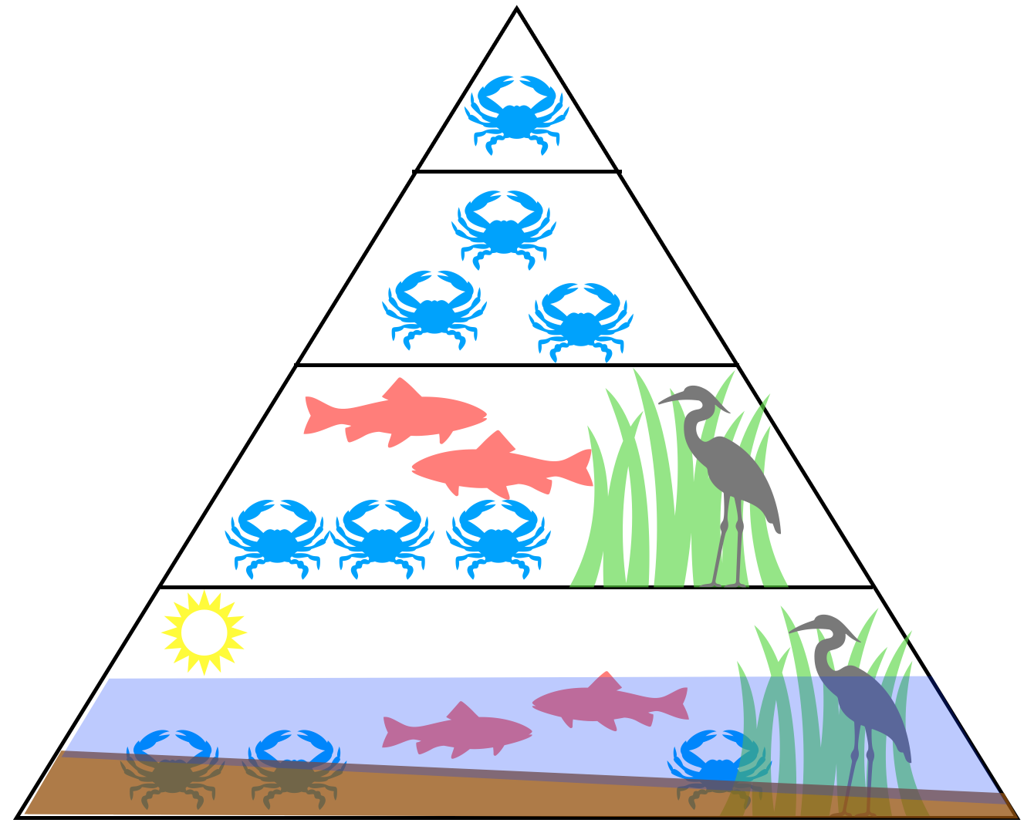
Ecological Levels of Organization
Notes:
Explain: Understanding the ecological levels of organization is really important because it helps us learn about how living things interact with each other and their environment. These levels, like individuals, populations, communities, and ecosystems, give us a way to study how everything is connected in nature. When we understand these levels, we can see how energy flows, how nutrients are recycled, and how different species depend on each other. This knowledge helps us make smart choices about taking care of the environment and using resources wisely. By understanding ecological levels, we can see how everything in nature is connected and feel a sense of responsibility to protect our planet and its different ecosystems.
You may choose to have students draw their own model using data and observations from yesterday’s biodiversity survey.

Slide 8
Biodiversity
Variety of life- all the different species you find in one area
Do you think biodiversity is important to an ecosystem’s resilience?
In science, resilience is the ability of an ecosystem to respond to disturbance by resisting damage and recovering quickly.
Notes:
Look for kids to discuss the many different species, and that if one species declines in population, that there are others to fill their role. Predators help keep populations in check, so that there is a balance. This concept will be explored further in the elaborate portion of this lesson.

Slide 9
What would happen if the oysters were removed from this ecosystem?
Notes:
Be sure to point out that the oysters are providing habitat for many organisms. Because they provide shelter for smaller fish, bigger fish then make their way to the reef.

Slide 10
Oysters are a keystone species, which are organisms that are critical to healthy ecosystems.

Slide 11
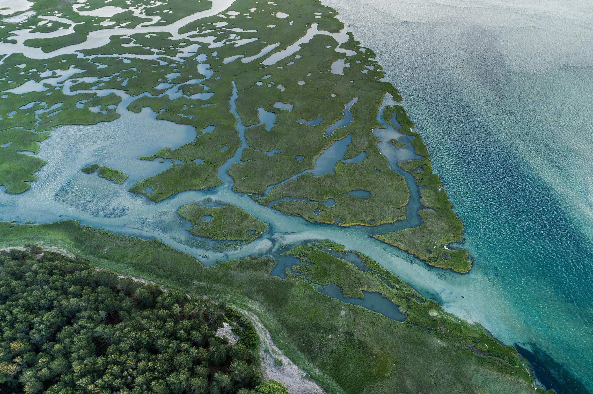
Estuary
Oysters are critical to the health of an estuary.
An estuary is an aquatic biome, where fresh and saltwater meet.
Biomes consist of multiple habitats found in a geographic area with similar physical characteristics and climate.
Some of the habitats found in estuaries include oyster reefs, salt marsh, mudflats, rivers and sounds.

Slide 12
Why are oysters are keystone species?
Create a list of evidence that supports the claim that oysters are a keystone species.
First, you will work individually, then you will have an opportunity to discuss your responses and explain how your evidence supports the claim.
At the end of Lesson 1, you will write a paragraph supporting the claim that oysters are a keystone species.
Notes:
This is a good place to stop and have the students reflect on the engage, explore and explain and list the evidence they have found to support this claim. You can have them work individually first, then share with a partner, then table group, then whole group. In their discussions, ask them to explain how the evidence supports the claim. When you reach the evaluate portion of the lesson, you may choose to let students use their notes for today’s activity.
Note: Throughout the unit students will find additional evidence to support their claim. For example, how oysters filter water and protect the shoreline from erosion. This lesson focuses on oysters as ecosystem engineers.

